Slide 1
Enhancing Park Safety Through Data-Driven Analysis in NYC Parks
“An In-depth Analysis Utilizing Python and Tableau” Ashwin Muthuraman
Tenneti Srinivas Saiteja
Bharath Genji Mohana Ranga

Slide 2
INTRODUCTION
Purpose and Scope: This project is dedicated to enhancing park safety by analyzing the intricate patterns of crime within New York City's parks, utilizing data from 2015 to 2023.
Data-Driven Approach: Leveraging the extensive NYC Park Crime dataset, our analysis employs advanced data manipulation with Python and sophisticated visualization techniques using Tableau to uncover critical insights.
Strategic Goals: We aim to identify crime trends, explore the relationship between park size and crime incidents, and evaluate the effectiveness of existing safety measures.
Community Impact: The insights gained from our analysis will inform strategic planning, aiming to boost park safety and improve community well-being across New York City.
Project Framework: By addressing specific SMART questions related to crime rates, trends across boroughs, and park safety benchmarking, we will provide actionable recommendations for park safety enhancements.

Slide 3
Project Objectives & Overview
Objective and Data Utilization
Methodology
Impact and Goals
Our project leverages extensive crime data from NYC parks spanning 2015-2023 to identify patterns, assess safety measures, and explore the relationship between park size and crime rates using advanced data analysis tools.
Employing Python for rigorous data cleansing and preprocessing, followed by using Tableau for dynamic visualization and in-depth trend analysis to provide stakeholders with actionable insights and enhanced interactive experiences.
By analyzing and visualizing crime trends, we aim to provide recommendations for safety improvements and strategic planning that can directly contribute to enhanced community well-being and safer public spaces in New York City.

Slide 4
The foundation of our project is the NYC Park Crime dataset, a rich compilation of crime incidents including murder, rape, robbery, and assault, augmented with park attributes like size and location.
NYC Park Crime Data: 2015-2023: https://www.nyc.gov/site/nypd/stats/crime-statistics/park-crime-stats.page
About: https://data.cityofnewyork.us/Public-Safety/NYC-Park-Crime-Data/ezds-sqp6/about_data
Data Sources

Slide 5

Methodology Overview
Our methodology is a two-fold approach using Python for data preparation and analysis, and Tableau for interactive visualization, aimed at extracting actionable insights from the complex data.
Tools Used:
Python
Tableau

Slide 6
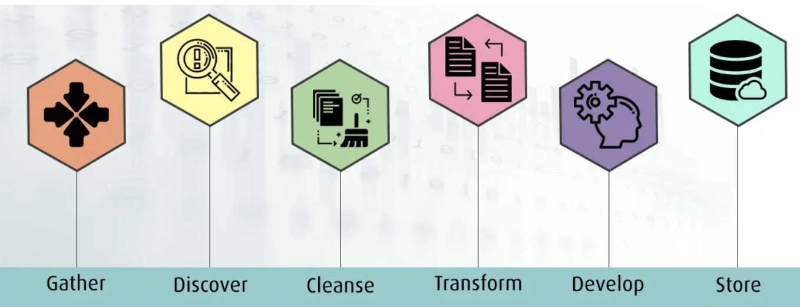
Data Preparation Steps
Cleaning and Preprocessing
Utilized Python's pandas library to cleanse the dataset by removing duplicates, filling missing values, and correcting inconsistencies to ensure data accuracy and reliability for analysis.
Data Normalization and Transformation
Applied normalization techniques to standardize the range of quantitative data and used NumPy for efficient transformations, enabling more meaningful comparisons and analyses across different scales and metrics.

Slide 7

SMART Questions
Crime Rate Evaluation
Determine the park with the highest overall crime rate in NYC for the year 2023.
Borough-based Crime Trends
Analyze the trend of total crimes reported from 2015 to 2023 across different boroughs.
Park Size-Crime Correlation
Investigate the correlation between park size and the total number of crimes in 2023.
Crime Category Proportions
Evaluate the proportion of rapes within the total park crimes for Q4 2023 and compare it with the previous year.
Benchmarking Park Safety
Identify the park with the lowest crime rates from 2015 to 2023 as a potential model for safety improvements.

Slide 8
Timeline
Jan | Feb | Mar | Apr | May
 |  | Project Developmen
Data Search & Pre-Processing
Data Analysis & EDA
Dashboard Development

Slide 9
Exploratory Data Analysis

Slide 10
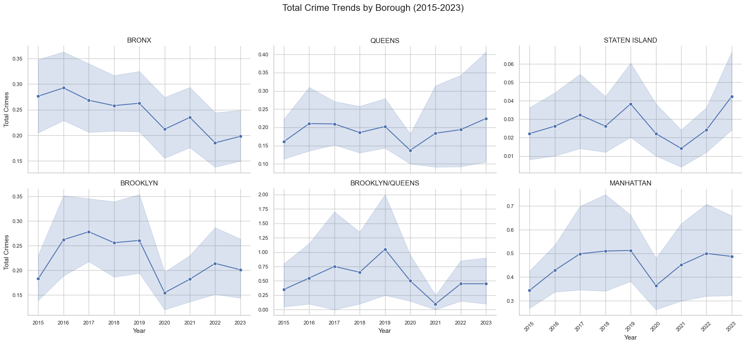
Total Crimes per Borough Over The Years
Varying Crime Rates: Each borough displays unique trends in crime rates over the years. This indicates that crime patterns are localized and may be influenced by borough-specific factors.
Temporal Fluctuations: There are notable fluctuations within each borough over time. These variations could be attributed to changes in law enforcement policies, socio-economic factors, or other events affecting crime rates.
Notes:
Peak Crime Periods: Some boroughs show peaks in certain years, where crime rates have spiked significantly. For instance, Staten Island shows a marked increase in crime rates towards the end of the period. Identifying the reasons behind these peaks could be vital for law enforcement and public policy.
Comparative Analysis: The scales on the y-axis differ, which suggests a significant disparity in crime rates between boroughs. This means comparing the magnitude of crime across boroughs directly from this chart is not straightforward. A consistent scale would be required for direct comparisons.
Trends Over Time: While some boroughs show a trend of increasing or decreasing crime rates, others display a more cyclical pattern, with rates rising and falling over the years.

Slide 11
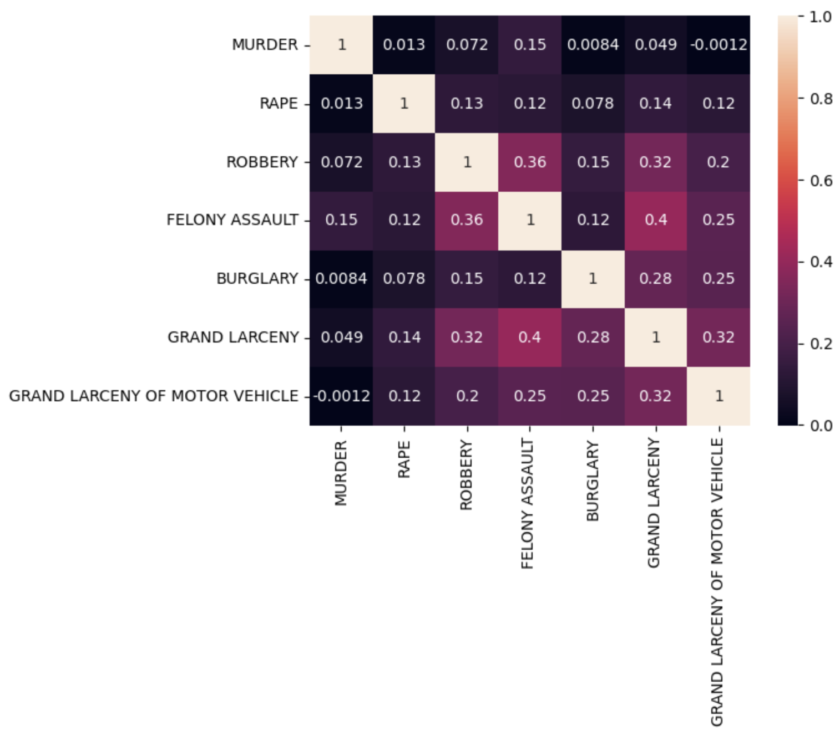
Correlation Matrix of Crime Types
Strength of Correlations: The matrix values range from -1 to 1, where 1 indicates a perfect positive correlation, -1 indicates a perfect negative correlation, and values closer to 0 indicate weaker or no correlation. Notable correlations are seen between robbery and felony assault (0.36), and grand larceny and grand larceny of motor vehicle (0.32), suggesting these crime types often occur with similar frequency or under similar conditions.
Color Coding: The use of a color gradient from pink to dark red enhances visual interpretation. Darker red shades indicate stronger positive correlations, while lighter shades and pink indicate weaker correlations. This visual aid helps quickly identify which types of crimes are more likely to correlate across the dataset.

Slide 12
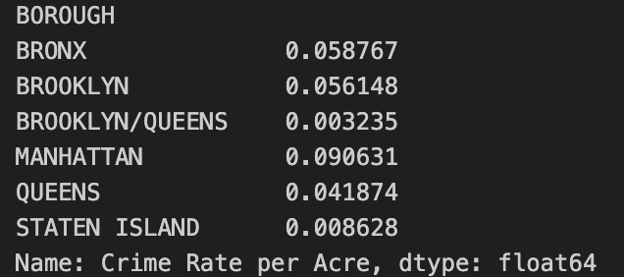
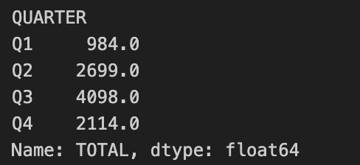
Crime Rate by Borough
The data table displays the crime rate per acre for each borough in New York City. Manhattan has the highest crime rate at approximately 0.090631, indicating a higher incidence of crimes per acre compared to other boroughs. The combined Brooklyn/Queens area shows the lowest crime rate at 0.003235.
Quarterly Crime Totals
The table lists the total number of crimes reported in each quarter. The third quarter (Q3) shows the highest crime total at 4098, suggesting a seasonal peak in crime rates during this period. The first quarter (Q1) records the lowest crime figures, with 984 incidents, indicating a possible seasonal decrease in crime activity during these months.

Slide 13
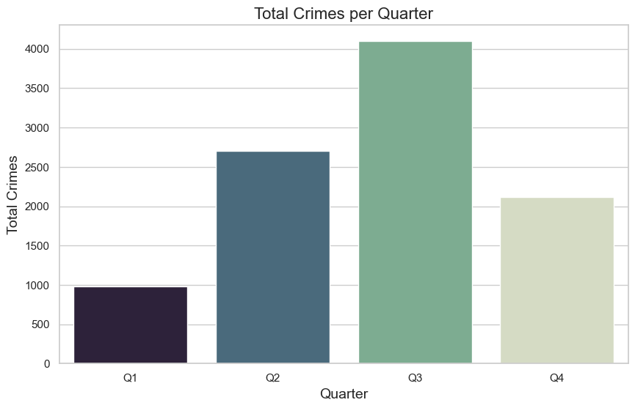
Total Crimes per Quarter
Seasonal Variability: The chart shows a significant increase in crime during the third quarter (Q3), which is represented by the tallest purple bar, indicating the highest crime occurrence in that period. This suggests a seasonal peak in criminal activity during these months. Conversely, the first quarter (Q1) has the lowest crime rates, as shown by the shortest light blue bar.
Comparison Across Quarters: There's a noticeable fluctuation in crime rates across the quarters. After a modest rise from Q1 to Q2 (blue bars), there's a sharp spike in Q3 followed by a decline in Q4 (dark purple bar), though the crime rate in Q4 remains higher than in Q1 and Q2. This pattern may indicate trends or external factors affecting crime rates through the year.

Slide 14
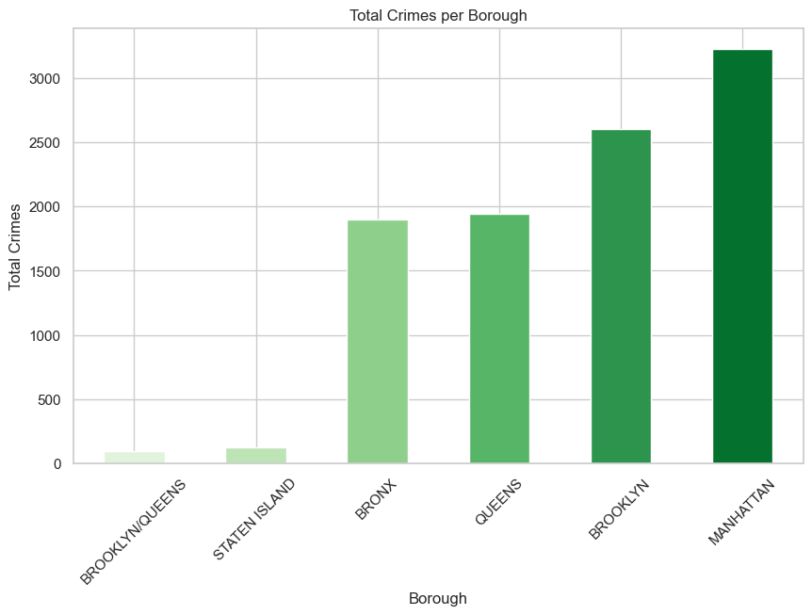
Mean Crime Rate per Acre for Each Borough
Differential Crime Rates: Manhattan has the highest average crime rate per acre, significantly surpassing the other boroughs, as indicated by the tall teal bar. This suggests that Manhattan experiences a denser occurrence of crimes relative to its size compared to other boroughs. In contrast, Staten Island has the lowest crime rate per acre, indicated by the shortest green bar.
Comparison Among Boroughs: The Bronx and Brooklyn have relatively similar crime rates per acre, both higher than Queens but significantly lower than Manhattan. The combined Brooklyn/Queens category, depicted with a very low crime rate, suggests a minimal occurrence of crimes in the areas where these two boroughs overlap or are considered together for statistical purposes.

Slide 15
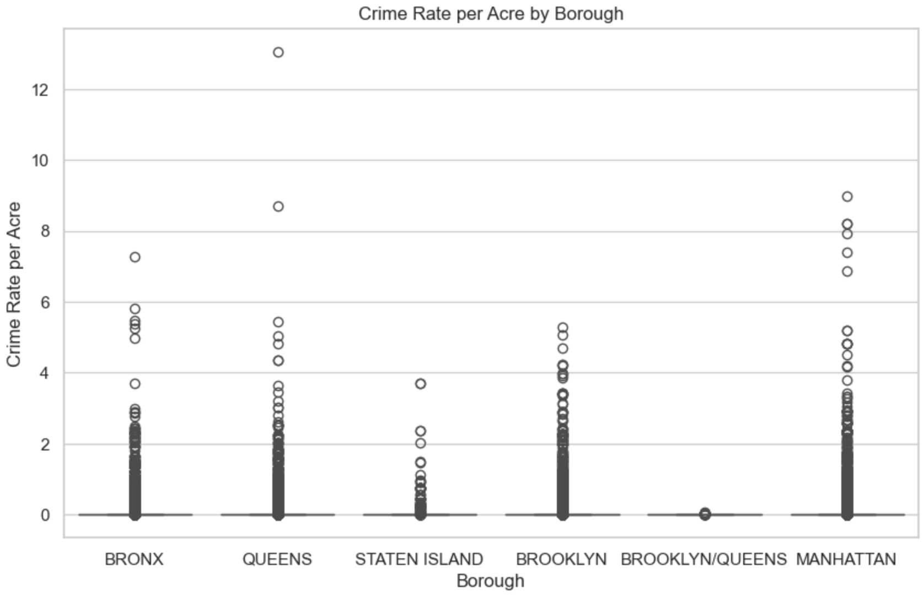
Crime Rate per Acre Distribution
Distribution and Variability: The plot uses individual dots to represent specific observations of crime rates per acre within each borough, showing the variability and range of data points. Manhattan shows the widest range of crime rates, with dots stretching up to the highest values on the graph, indicating significant variation and some extreme values. In contrast, boroughs like Staten Island and the combined Brooklyn/Queens area display much tighter clusters of data points, suggesting less variability in crime rates.
Comparative Analysis: Comparatively, Manhattan has not only the highest peak in crime rates but also the highest density of crime rates around the median, which is higher than in other boroughs. The Bronx, Brooklyn, and Queens show a moderate level of distribution, indicating a more consistent range of crime rates. Staten Island and the Brooklyn/Queens combined area have the lowest density and variability of crime rates, as reflected by fewer and lower dots.

Slide 16
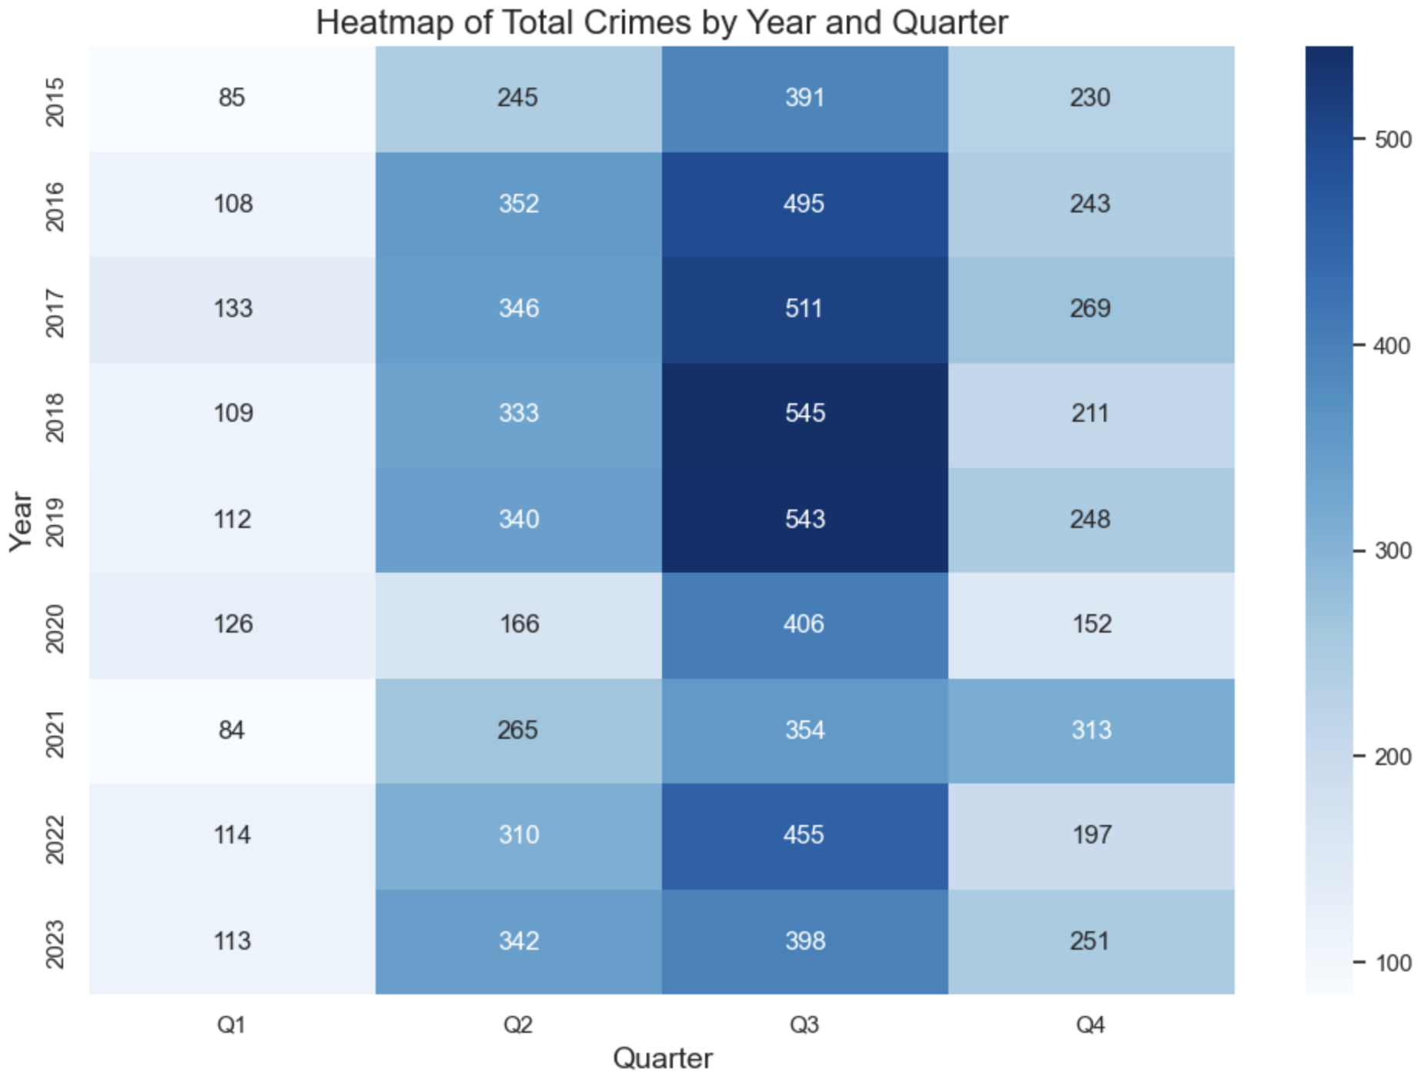
Heatmap of Crimes by Year and Quarter
Temporal Trends and Seasonal Patterns: The heatmap shows that crime rates tend to be higher in the third quarter (Q3) of each year, as indicated by the darker shades of blue. This pattern is consistent throughout the years, suggesting a seasonal increase in crime during these months. Conversely, the first quarter (Q1) typically shows the lowest crime rates each year, marked by lighter colors.
Year-to-Year Comparison: From the heatmap, one can observe an overall high level of crime in Q3 across most years, with notable peaks in 2017, 2018, and 2019 where crime rates exceeded 500. The year 2020 shows a significant drop in Q4, potentially indicative of external factors affecting crime rates, such as the COVID-19 pandemic. The data in 2021 and beyond shows a somewhat variable pattern, possibly indicating changes in crime trends or the effectiveness of law enforcement and crime prevention measures.

Slide 17
TABLEAU ANALYSIS

Slide 18
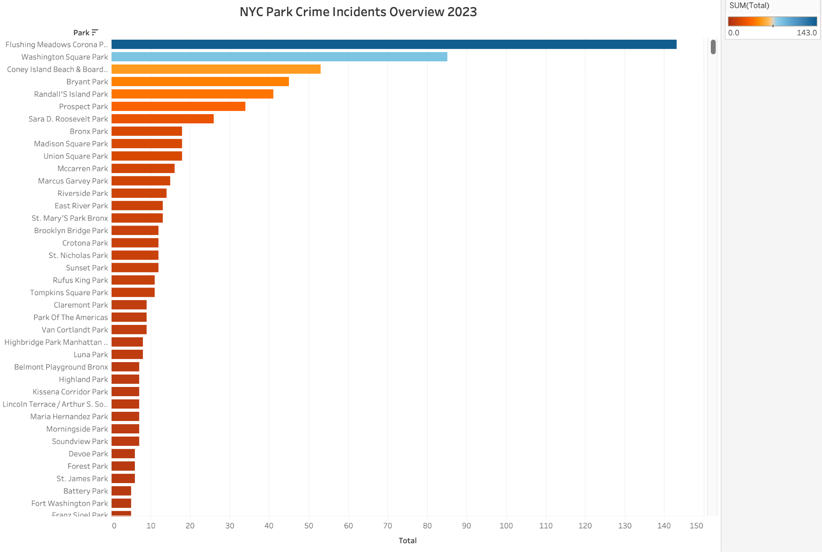
NYC Park Crime Incidents Overview 2023
Variation in Crime Rates Across Parks: The chart shows a significant variation in crime incidents across different parks. Flushing Meadows Corona Park, Washington Square Park, and Coney Island Beach & Boardwalk have the highest number of reported incidents, indicated by the longer bars. These parks might be larger or more frequented, potentially contributing to higher crime rates.
Low Crime Incidence Parks: On the other end, parks like Fort Washington Park, Franz Sigel Park, and Battery Park are among those with the fewest reported incidents, as shown by the shorter bars. This suggests that these parks might be safer or less crowded, leading to fewer opportunities for crimes to occur.

Slide 19
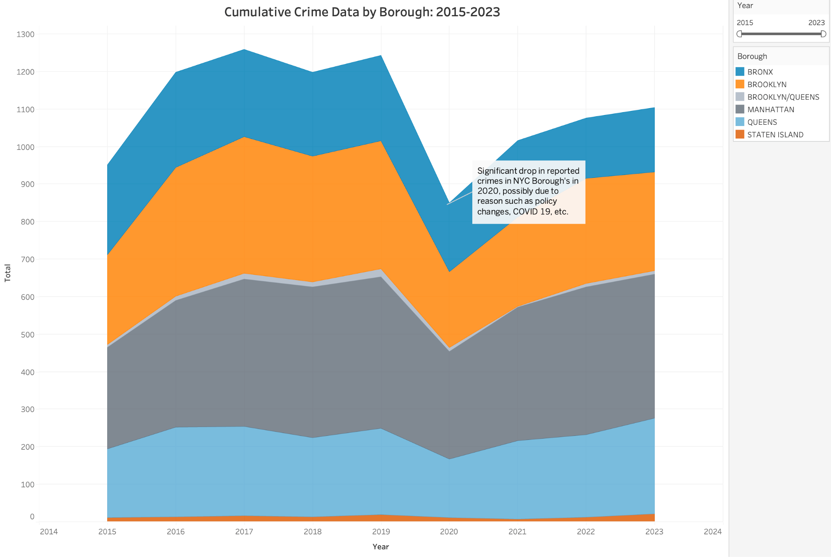
Cumulative Crime Data by Borough: 2015-2023
Trend Analysis: The chart shows that Brooklyn has consistently reported the highest number of crimes, indicated by the large orange area. Staten Island consistently shows the fewest crimes, as represented by the small light gray area at the bottom. All boroughs display a significant dip in crime rates around 2020, which the annotation attributes to factors such as policy changes and the COVID-19 pandemic.
Comparative Insights: The visualization allows for a comparison across boroughs and over time, revealing how crime trends have shifted. While the total crime rates for most boroughs tend to move in parallel, the sharp decrease in 2020 across all boroughs and the subsequent partial recovery in the following years are particularly noteworthy, reflecting the impact of external societal changes on crime rates.

Slide 20
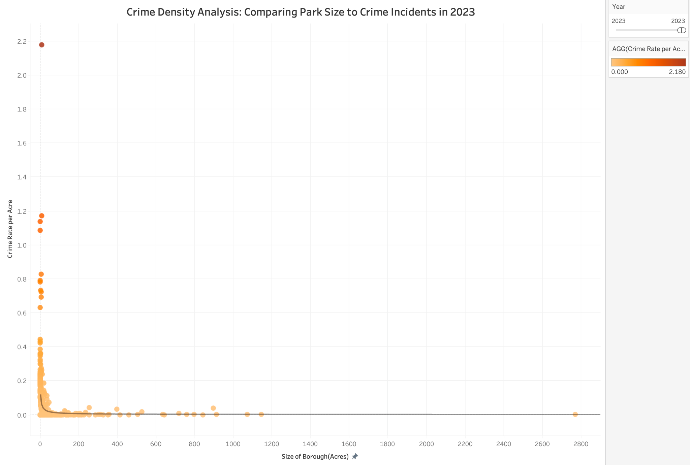
Crime Density Analysis: Comparing Park Size to Crime Incidents in 2023
Higher Crime Rates in Smaller Parks: The crime rate per acre tends to be higher in smaller parks. This is evident from the cluster of data points with high crime rates at the left side of the plot, where park sizes are smaller.
Decrease in Crime Rate with Increasing Park Size: As the size of the parks increases, the crime rate per acre decreases significantly. This trend is illustrated by the gradual decline in crime rate values as we move from left to right on the plot, showing lower crime rates in larger parks.

Slide 21
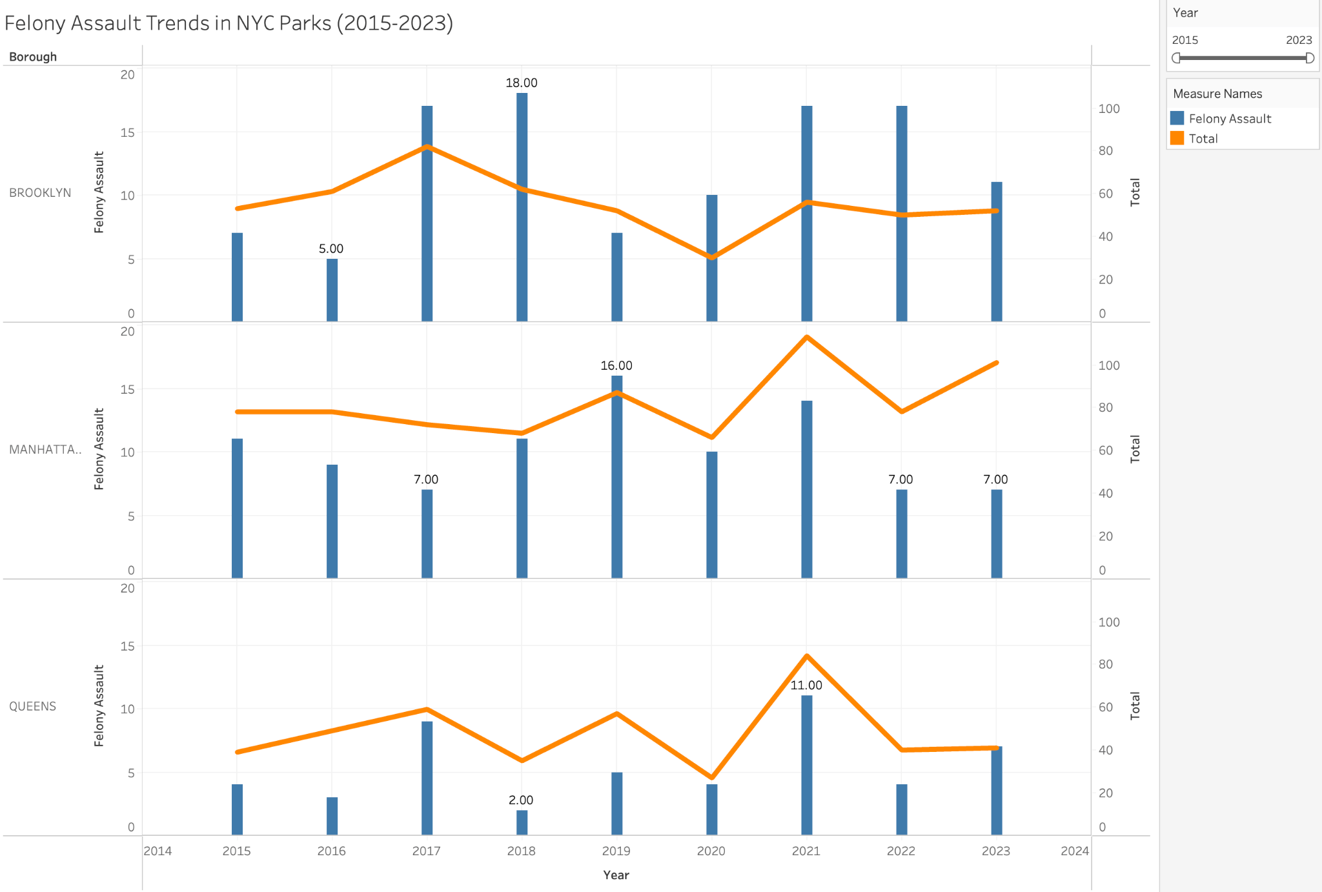
Felony Assault Trends in NYC Parks (2015-2023)
Variable Trends Across Boroughs: Brooklyn has experienced fluctuations in felony assault cases with a noticeable peak around 2019 and a recent decline in 2023. Manhattan shows a somewhat steady pattern with slight increases and plateaus, while Queens has fewer incidents overall, with a peak in 2021 before declining.
General Decline in Recent Years: Despite the fluctuations, all three boroughs show a general decline in felony assaults in parks in the most recent year, 2023, suggesting an overall improvement in park safety or effective law enforcement strategies.

Slide 22
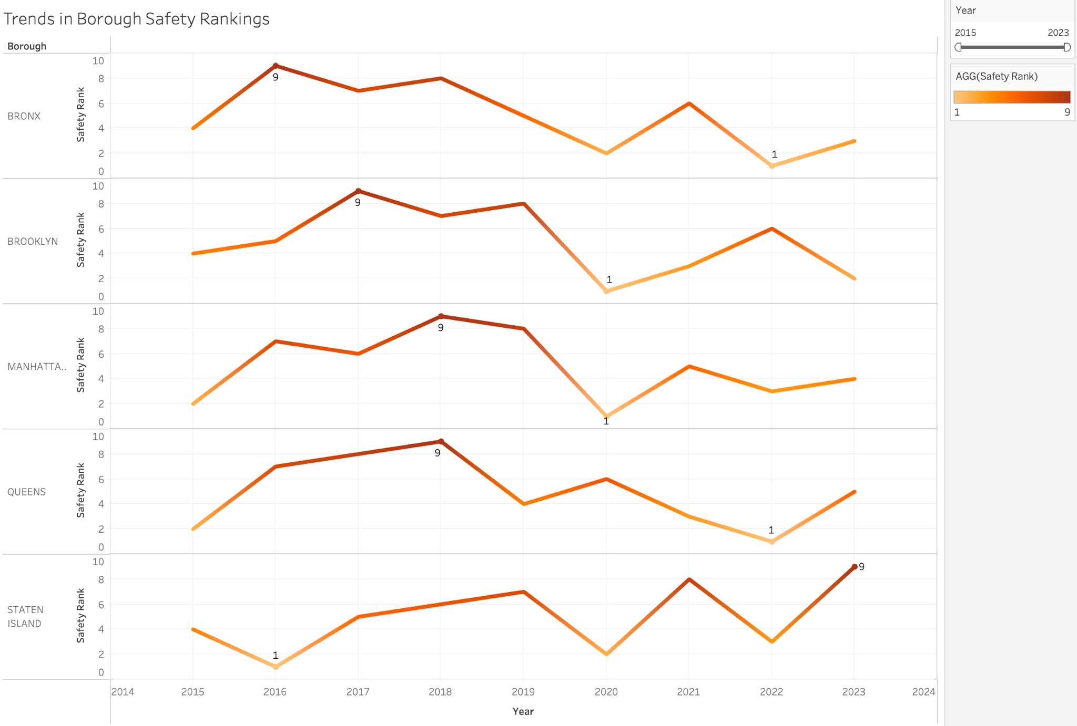
Trends in Borough Safety Rankings
Fluctuating Rankings Over Time: All boroughs show fluctuations in their safety rankings over the years. For instance, Brooklyn and Manhattan have both held the safest (rank 1) and the least safe (rank 9) positions at different times, indicating changes in safety conditions or differing crime rates over the period.
Current Trends in 2023: As of 2023, Brooklyn and Staten Island are the least safe (rank 9), whereas the Bronx and Queens are safer (rank 1), showing a significant variation in perceived safety across the boroughs in the most recent year.

Slide 23

LIMITATIONS
Data Aggregation: Some graphs combine data from multiple boroughs (e.g., Brooklyn/Queens), which could obscure specific trends and factors affecting crime rates in each distinct area. Disaggregating this data might provide more precise insights.
Seasonal Adjustments: Although some graphs show seasonal variations, there is limited discussion on whether the data have been adjusted for seasonal effects beyond visual representation. Including statistical adjustments for seasonality could provide a clearer picture of underlying trends.
Lack of Contextual Factors: The graphs primarily focus on the crime numbers without integrating socio-economic, demographic, or policy change data that could significantly affect crime trends.

Slide 24

FUTURE DIRECTIONS
Incorporating Additional Data: Future analyses could benefit from integrating more contextual data such as economic indicators, population density changes, or law enforcement strategies to understand the dynamics influencing crime rates more comprehensively.
Longitudinal Studies: Continued longitudinal studies could help in understanding the long-term effects of policies and global events (like the COVID-19 pandemic) on crime trends.
Predictive Analytics: Applying predictive models to the crime data could help forecast future trends based on existing patterns, assisting in proactive crime prevention and resource allocation.

Slide 25

LESSONS LEARNED
Impact of External Factors: The significant drop in crime rates during 2020 across all boroughs, as highlighted in the area chart, underscores the profound impact of external factors such as the pandemic and associated policy changes (e.g., lockdowns) on crime dynamics.
Utility of Visual Data Representation: The various charts (area, bar, heatmap) demonstrate the utility of visual data representation in quickly conveying complex information and trends, which is crucial for policymakers, law enforcement, and the public.
Seasonal Crime Fluctuations: Data from different graphs suggest that crime rates fluctuate seasonally, with higher rates typically in the warmer months. This insight is crucial for planning law enforcement strategies and public safety measures.

